Slide 1

Yellow Taxi Demand Prediction
Tinsae Alemayehu
April 2019

Slide 2

Contents
Initial Exploration
EDA: Analyzing Locations
Data Cleaning
Univariate Forecasting
LSTM Networks

Slide 3





Yellow Taxis
Keep of the fares.
Notes:
The right to peak street hailing and prearrange passengers anywhere in NYC
Medallions are bought in Millions by private cab companies
Lease to their drivers
Keep 100% fo the fares/tips, they have to pay lease price
Everything is regulated by NYC Taxi and Limousine Commissison
Lease price
Fares

Slide 4
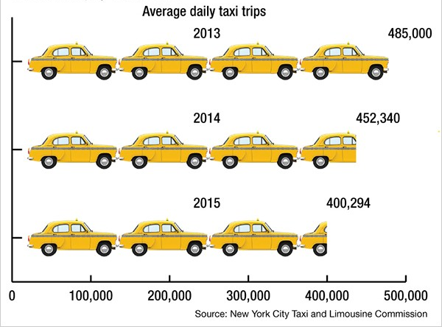


The Uber Effect
Number of Uber trips outpaced yellow taxis for the first time in 2018
65000
13500
Notes:
Uber/Lyft are popular
Uber started in 2011 but number of trips outspaced yellow taxis for the first time in 2018
Taxis are not easily found. Riders wait longer when demand exceeds supply
13500 medallion cabs in NYC
They may not satisfy all the demand, but possible to improve their utilization

Slide 5



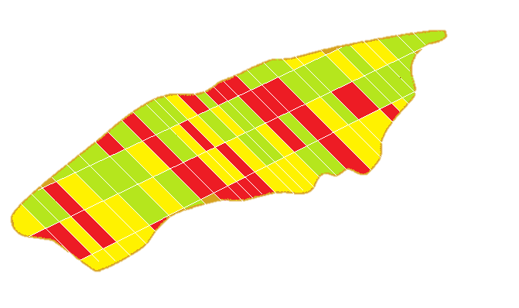
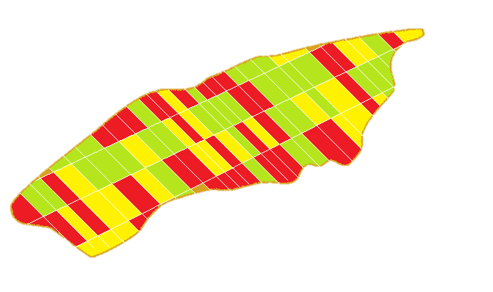





The Product
April 17 2019: 1:28 AM
Close
10 min Forecast
10 min
Current Location
High Demand
Average Demand
30 min
Low Demand
1 hour
3 hours
6 hours
1:28 AM - 1:38 AM
1:38 AM - 1:48 AM
Notes:
The model can make real time predictions about the demand in the next 10 minutes at different locations in newyork city.
The number of pickups at location is correlated with the total amount of fares earned by drivers who picked those trips.
The goal is not only to fulfill demand but also to maximize profit for drivers and reduce their frustration.
The model shows which pickup location has a potential to give you a trip with large fares.
Large fares are correlated with longer trip distance and duration

Slide 6


Initial Exploration
2016
The data on Kaggle is cleaned and resampled data for 2016
170 M records, 16 GB space
Notes:
The data that is on Kaggle is 2014/15
I used the recently released data for 2017 and 2018 directly from NYC open data
The data contains 170 million records taking 16GB disk space
This doesn’t mean 16 GB ram is enough to load it
Processing it in Pandas is not possible on my pc – 8 gb ram
Not even on Google Colab- 12 gb ram

Slide 7

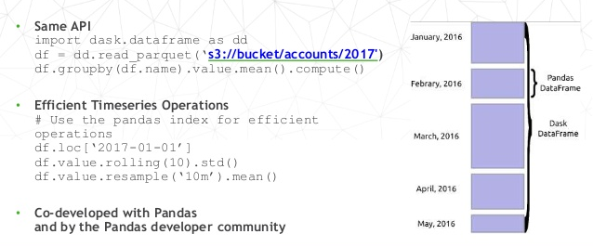
Initial Exploration
Notes:
Big data can be handled with Spark
Spark is another technology which requires time to learn it
Dask is a native parallel analytics tool designed to integrate seamlessly with the libraries I am already using: Pandas, NumPy, Scikit-Learn.
Dask works well on a single machine to make use of all of the cores on your laptop and process larger-than-memory data
It transfers part of the data to disk and that can take time
Working with dask on larger memory computer is faster
If everything can be loaded to memory Pandas is faster. That is not often the case

Slide 8


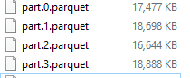
Initial Exploration
Dask doesn’t support “index_col” keyword argument
2017: 165 Partitions
2018: 92 Partitions
Setting new index from unsorted column is expensive
Positional row indexing(iloc) & label indexing(loc) is not possible
Notes:
Dask is still in the early stages. No tutorial except youtube videos from the developers and the documentation
A few trial and error will quickly fill up the memory had I not used Google Cloud Platform
I worked on 8 cores, 30 GB RAM. Dask divided 2017 data into 165 and 2018 data into 92
Dask decideds the block-size for each partition and number of partitions depending on the given memory
I faced three challenges
* Setting new index from unsorted column is expensive in Dask
* Many operations, like groupby-apply and join on unsorted columns require setting index
*Positional row indexing(iloc) and label indexing(loc) is not possible in Dask. Dask doesn't maintain indices or labels of the whole dataframe.

Slide 9
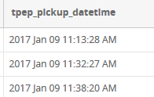



Initial Exploration
Parsing Date
y2017 = dd.read_csv(
‘2017_trips.csv’,
dtype=dtypes_s
parse_dates=
["tpep_pickup_datetime",
"tpep_dropoff_datetime"])
Load dates as strings
tpep_pickup_datetime: object
tpep_dropoff_datetime: object
Notes:
Dask dataframe default parser is very slow and takes forever to complete.
*In the original data the dates are stored as strings in unusual format
I tried in many ways to parse the dates as efficiently as possible. The problem with Dask’s default parser is known by the developers and they are working to fix the problem on the next release

Slide 10


Initial Exploration
Parsing Date
'datetime64[ns]'
# parse dates # convert string to numpy date type
def parse_dates(df):
df = df.assign(tpep_pickup_datetime=pd.to_datetime(df['tpep_pickup_datetime'],
="%m/%d/%Y %I:%M:%S %p"))
df = df.assign(tpep_dropoff_datetime=pd.to_datetime(df['tpep_dropoff_datetime'],
="%m/%d/%Y %I:%M:%S %p"))
return df
# map_partition applies a function to each partition # delayed
y2017_ddf = y2017_ddf.map_partitions(parse_dates, meta=meta_all)
y2018_ddf = y2018_ddf.map_partitions(parse_dates, meta=meta_all)
Notes:
I tried in many ways to parse the dates as efficiently as possible. The problem with Dask’s default parser is known by the developers and they are working to fix the problem on the next release
I read through numerous posts on Stackoverflow and Github
Finally came with a working solution.

Slide 11


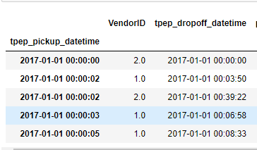
Initial Exploration
set-index
'datetime64[ns]'
Remove Erroneous Dates
Dask is fast when
indexed by time
2068
Dec 31 to Jan 01
Decrease memory burden
2001
02/02/2009 11:00 PM
to
02/02/2009 11:20 PM
Notes:
I tried in many ways to parse the dates as efficiently as possible. The problem with Dask’s default parser is known by the developers and they are working to fix the problem on the next release
I read through numerous posts on Stackoverflow and Github
Finally came with a working solution.

Slide 12
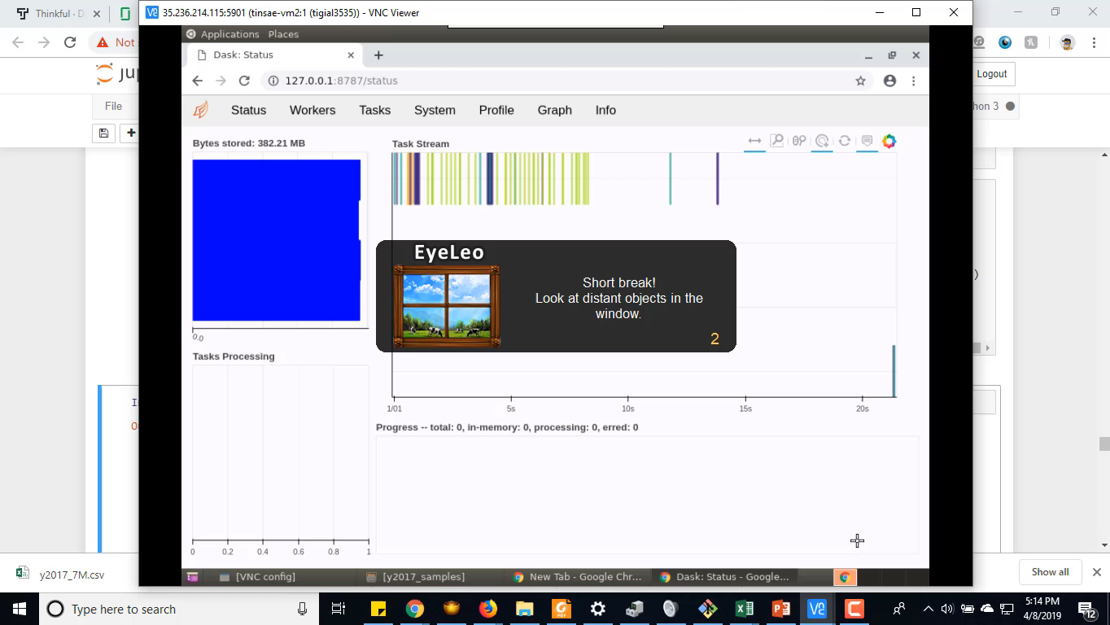
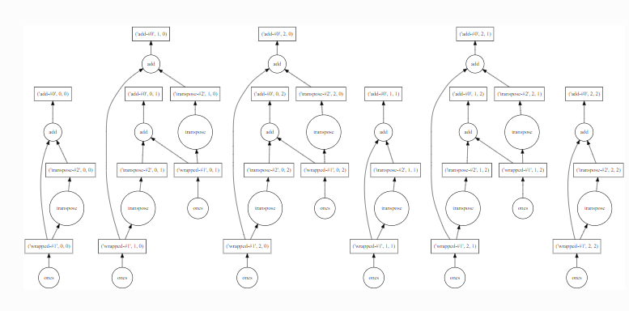
Initial Exploration
import dask.array as da
x = da.ones((15, 15), chunks=(5, 5))
y = x + x.T
# y.compute()
y.visualize(filename='transpose.svg')
Notes:
Dask stores dataframe computations as dask delayed
We can see the computation graph
To show the top of the dataframe dask will not process all data. It will quickly process only what is required.
The video shows how dask processes in distributed way

Slide 13
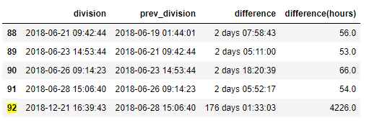
EDA: Analyzing Locations and Time Interval

Slide 14
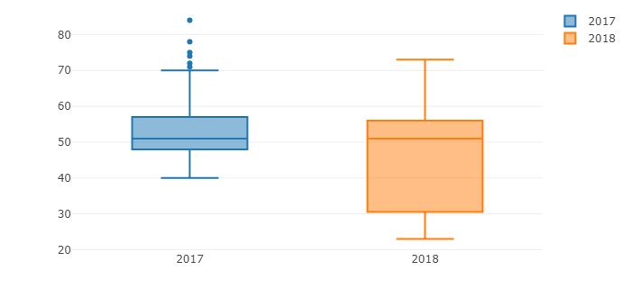
EDA: Analyzing Locations and Time Interval
Partition Interval
hours
year

Slide 15
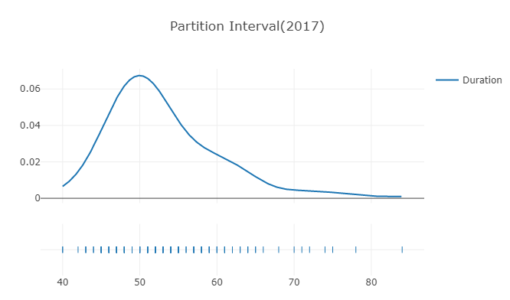
EDA: Analyzing Locations and Time Interval

Slide 16
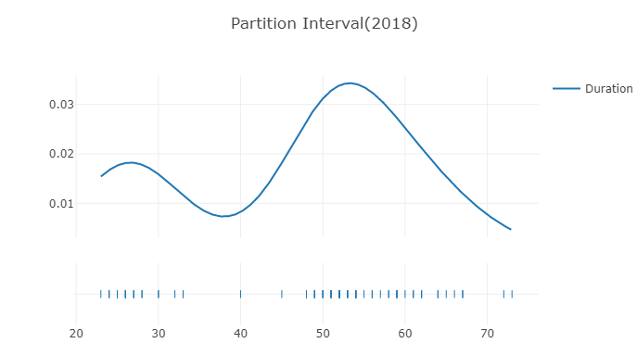
EDA: Analyzing Locations and Time Interval

Slide 17
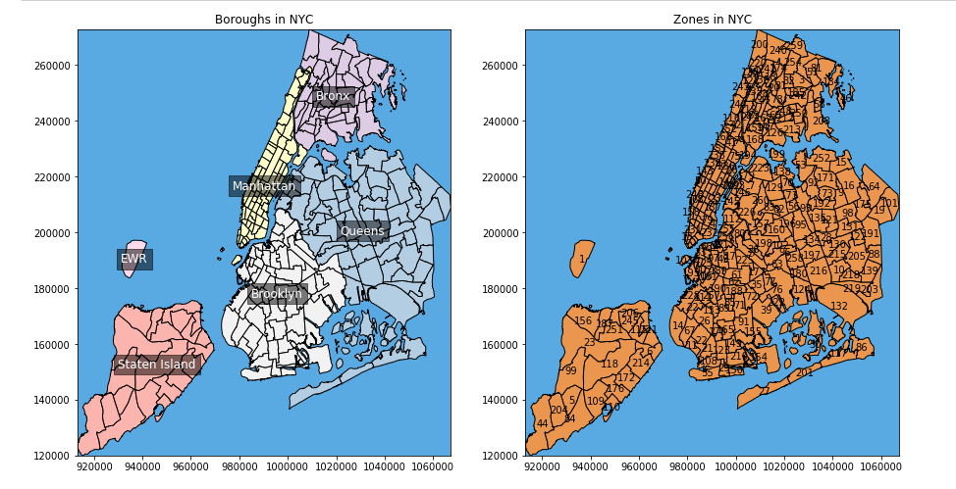
EDA: Analyzing Locations and Time Interval

Slide 18
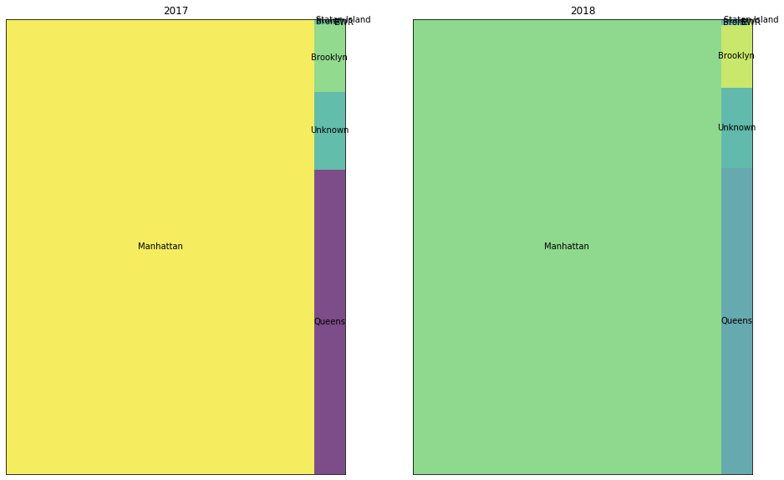
EDA: Analyzing Locations and Time Interval
Number of Trips
Manhattan
6%
6%
90%
Queens

Slide 19
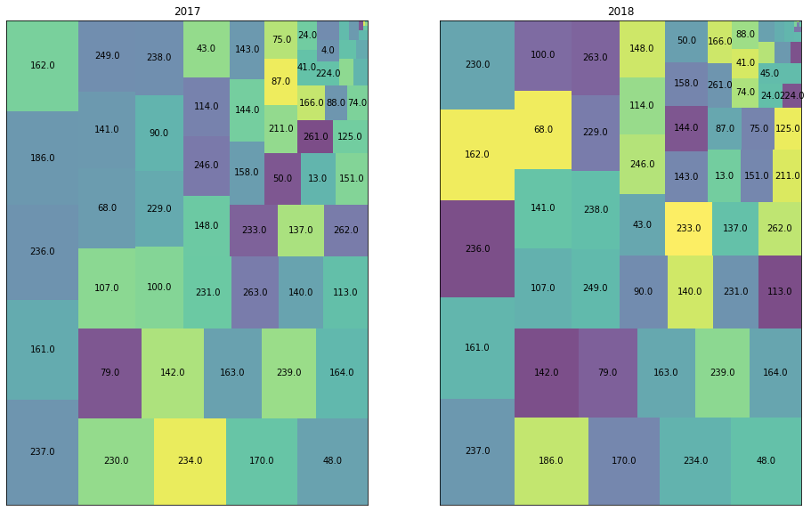
EDA: Analyzing Locations and Time Interval
Trips in Manhattan
95 % of trips that originated from Manhattan ended in Manhattan.

Slide 20
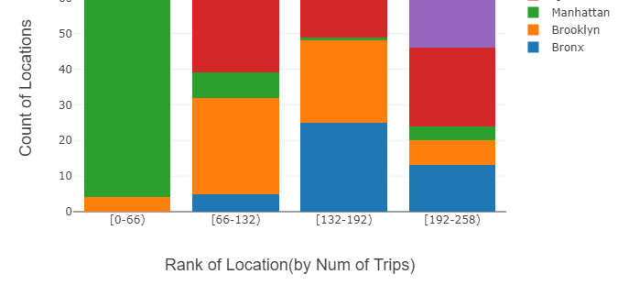
EDA: Analyzing Locations and Time Interval
Almost all locations in Manhattan are in the [0-66] bar

Slide 21
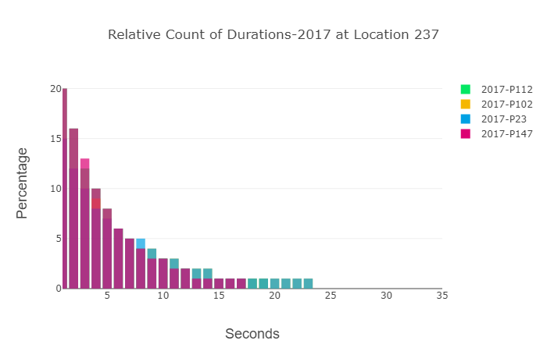
EDA: Analyzing Locations and Time Interval
There are trips every 25 seconds at most at location 237.

Slide 22
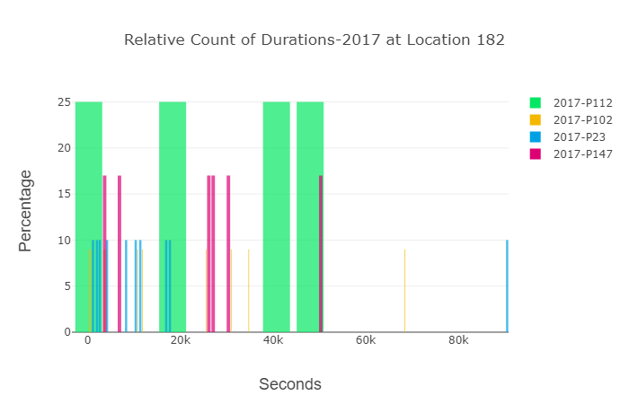
EDA: Analyzing Locations and Time Interval
Trip interval goes up to 90k ( 25 hours) for location 182

Slide 23

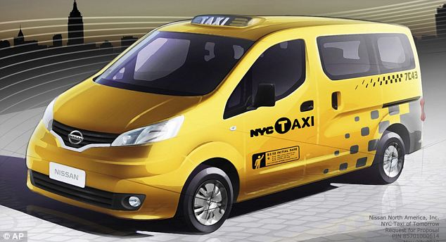
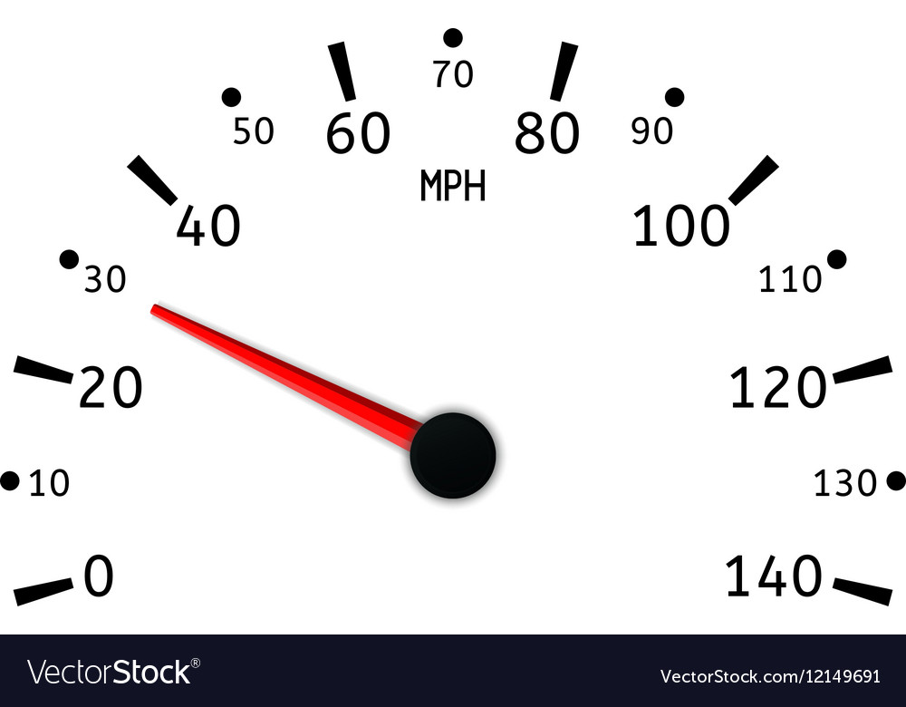
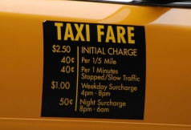
Data Cleaning and Feature Selection
Passenger Count
Duration/Speed
Remover passenger counts which are greater than 6 or less than zero
Trip Distance / Fares
Keep durations which are greater than 0
Standard fare only. Remove negative or unreasonable distances

Slide 24
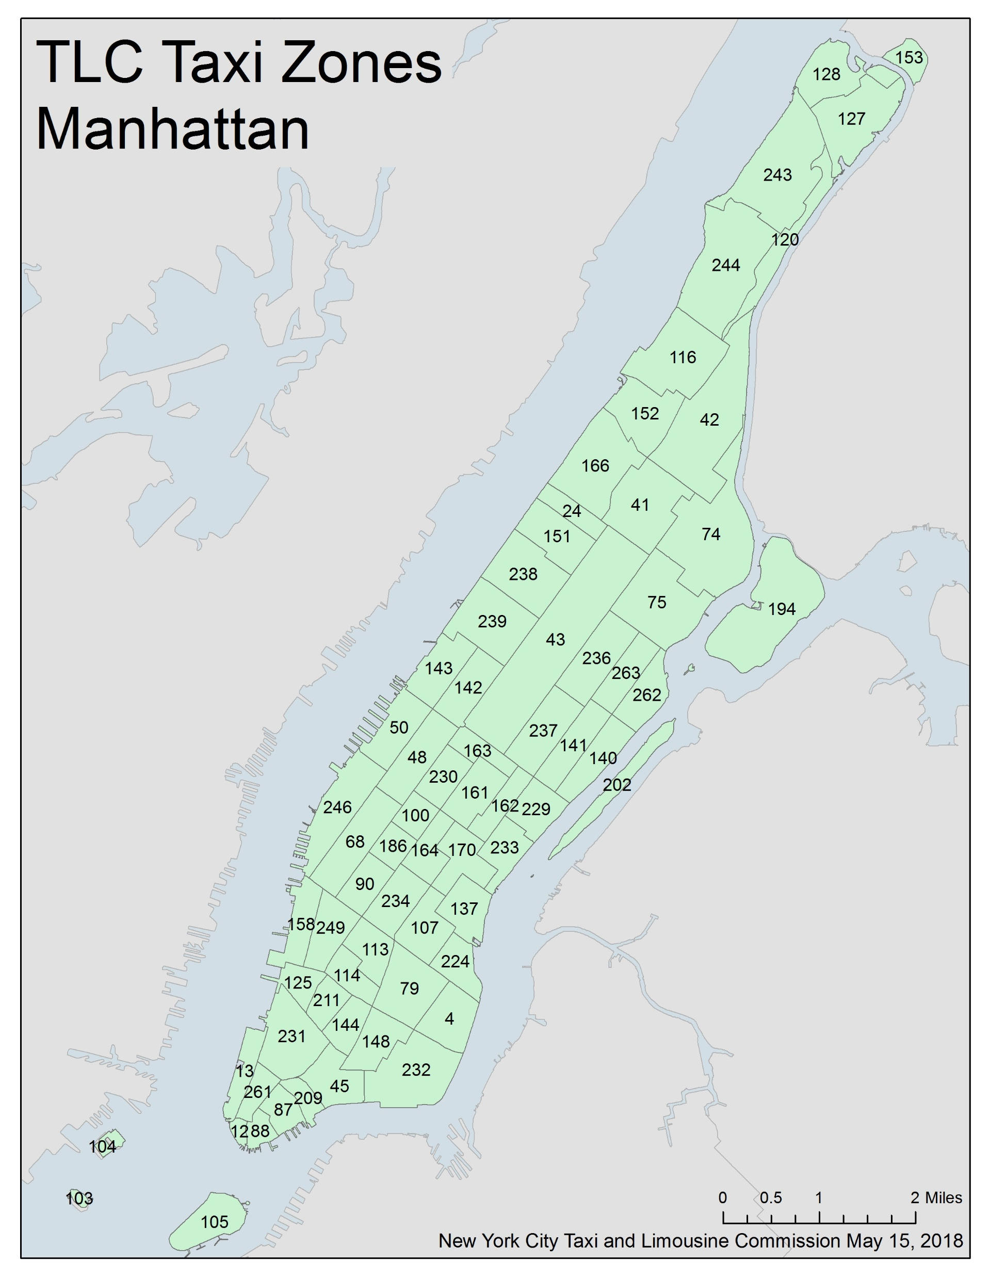
Data Aggregation
The average trip duration in Manhattan is around 10 minutes
75% of the trips are less than 2 miles
Group by location and resample every 10 minutes
Apply sum to fares_amout, passenger_count and trip_distance

Slide 25
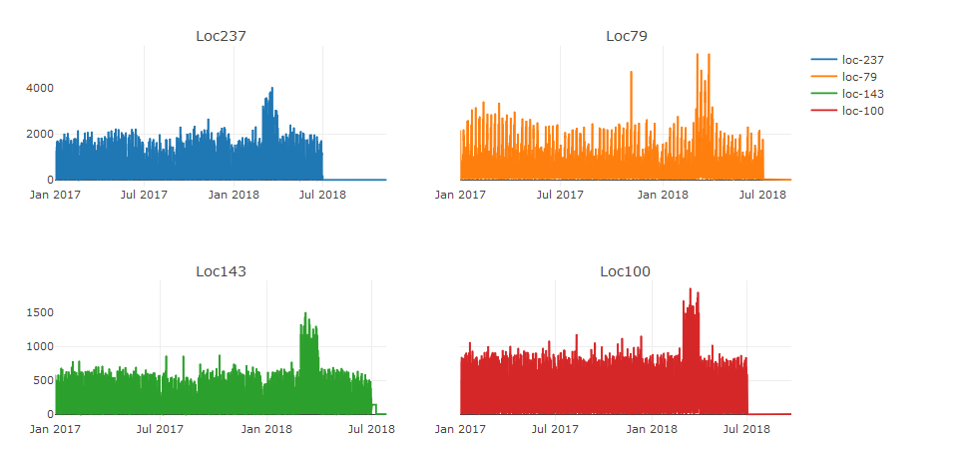
Univariate time-series Forecasting
Overall
Notes:
The rolling statistics plot shows that the mean and standard deviations get high in the morning and seem stable until midnight

Slide 26
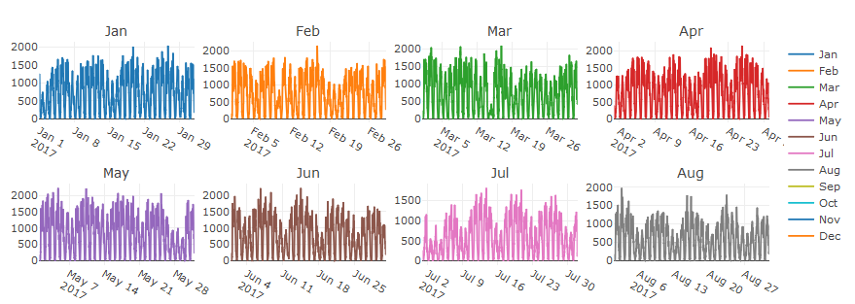
Univariate time-series Forecasting
Monthly-Loc 237
Notes:
The rolling statistics plot shows that the mean and standard deviations get high in the morning and seem stable until midnight

Slide 27
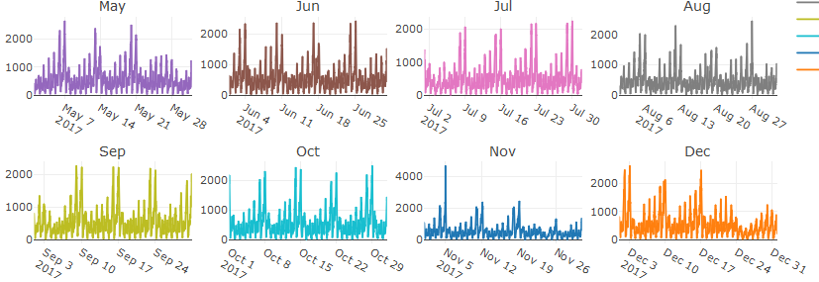
Univariate time-series Forecasting
Monthly- Loc 79
Notes:
The rolling statistics plot shows that the mean and standard deviations get high in the morning and seem stable until midnight

Slide 28
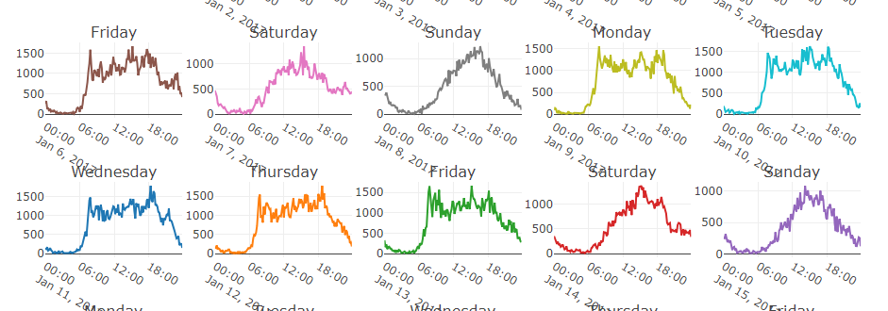
Univariate time-series Forecasting
Daily Pattern at Loc 237
Notes:
The rolling statistics plot shows that the mean and standard deviations get high in the morning and seem stable until midnight

Slide 29
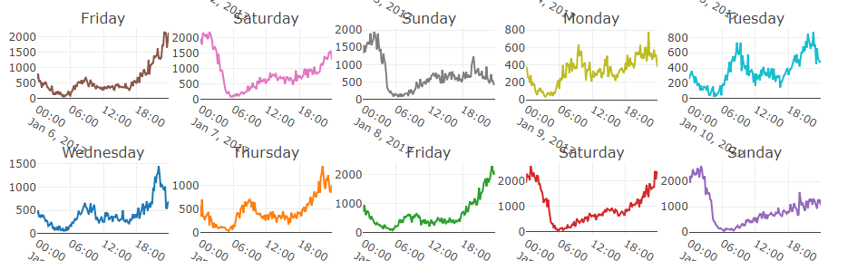
Univariate time-series Forecasting
Daily Pattern at Loc 79
Notes:
Loc 79 peaks around midnight

Slide 30
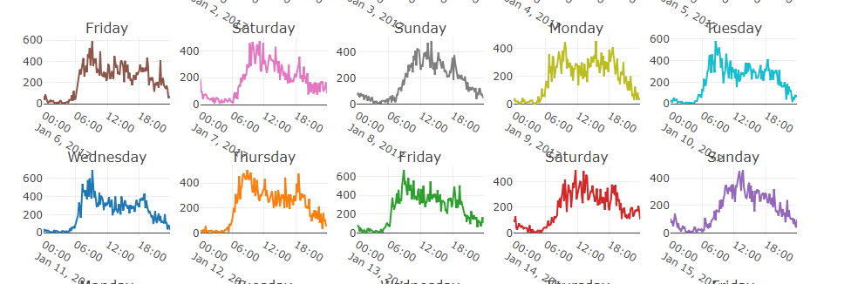
Univariate time-series Forecasting
Daily Pattern at Loc 143
Notes:
Peaks in the morning

Slide 31
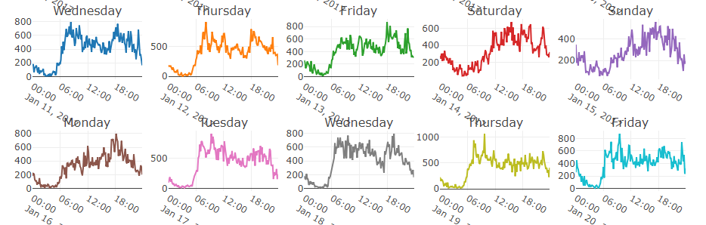
Univariate time-series Forecasting
Daily Pattern at Loc 100
Notes:
Some variations

Slide 32
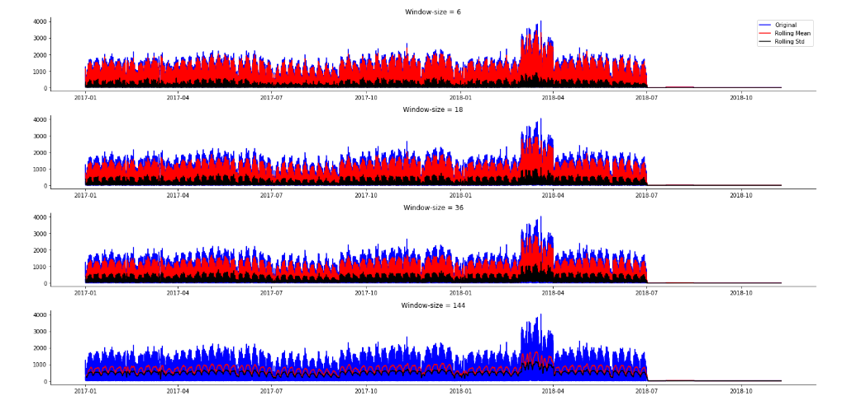
Univariate time-series Forecasting
Rolling Statistics

Slide 33
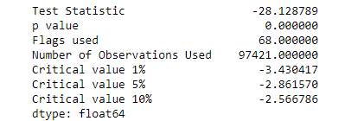
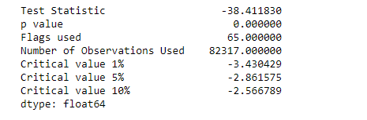
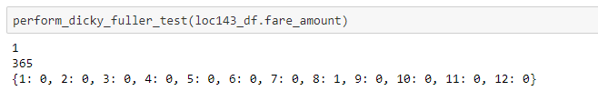
Test of Stationarity: ADF Test
Notes:
Even daily ADF shows stationarity

Slide 34
Test of Stationarity: ADF Test
p-value > 0.05: Accept H0, the data has a unit root and is non-stationary
p-value ≤ 0.05: Reject H0. the data does not have a unit root and is stationary
Notes:
Even daily ADF shows stationarity

Slide 35
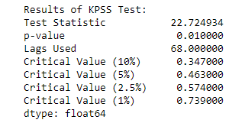
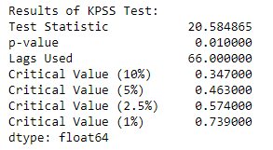
Kwiatkowski-Phillips Test
Null Hypothesis: The process is trend stationary.
Alternate Hypothesis: The series has a unit root (series is not stationary).
KPSS shows that the data is not stationary while ADF says it is. ADF measures difference stationarity while KPSS measures trend stationarity. ARIMA differencing can remove at least a linear trend.

Slide 36
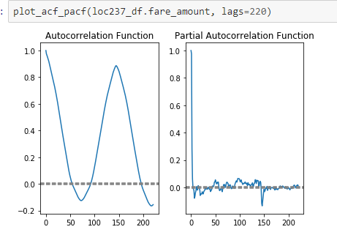
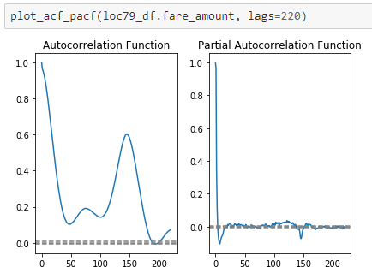
PACF and ACF plots
Notes:
ACF describes the autocorrelation between an observation and another observation at a prior time step that includes direct and indirect dependence information.
The partial autocorrelation at lag k is the correlation that results after removing the effect of any correlations due to the terms at shorter lags.
The cone is showing 95% confidence interval. It suggets that correlation values outside of this interval are very likely a correlation and not a statistical fluke. So I look at the lags until the graph enters the confidence interval

Slide 37
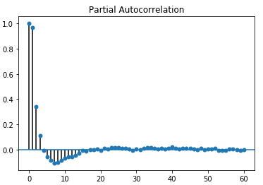
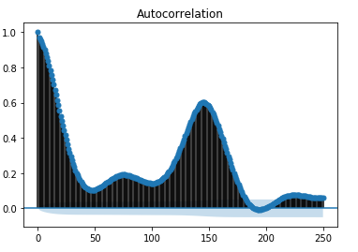
PACF and ACF plots
Notes:
The cone is showing 95% confidence interval. It suggets that correlation values outside of this interval are very likely a correlation and not a statistical fluke. So I look at the lags until the graph enters the confidence interval

Slide 38
PACF and ACF plots
Autocorrelation plot shows that the number of lags(q) for MA shall be somewhere between 50 and 60 for location 237 and between 195 and 205 for location 79.
Grid search for the best hyperparameters based on AIC
(3, 0, 9) 656091.7336373809
Partial auto correlation for both locations shows that p is between 0 and 5
Notes:
The cone is showing 95% confidence interval. It suggets that correlation values outside of this interval are very likely a correlation and not a statistical fluke. So I look at the lags until the graph enters the confidence interval

Slide 39
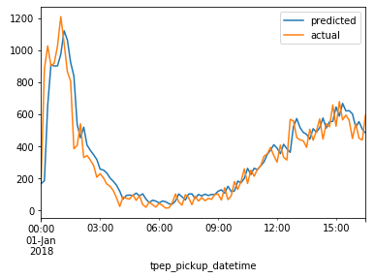
Walk Forward Validation
Split the dataset into training and test sets.
Walk the time steps in the test dataset.
Train an ARIMA model.
Make a one-step prediction.
Store prediction; get and store actual observation.
Calculate error score for predictions compared to expected values.
The model is trained on 2017 data and tested on 2018 data.
RMSE $113
Notes:
The average prediction error is $113

Slide 40
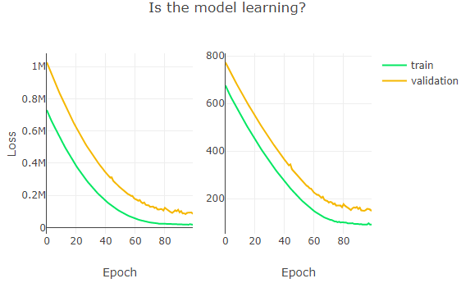
LSTM Networks
Vanilla LSTM(24 steps back)
(52536, 24, 1) (52536, 1) (26040, 24, 1) (26040, 1) 90.41663697046542, 147.8938028713525
Notes:
Not bad

Slide 41
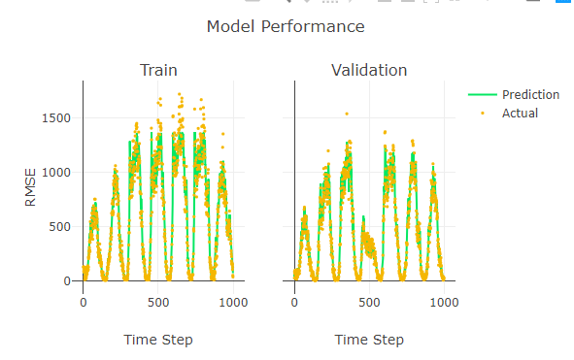
LSTM Networks
Vanilla LSTM(24 steps back)
(52536, 24, 1) (52536, 1) (26040, 24, 1) (26040, 1) 90.41663697046542, 147.8938028713525

Slide 42
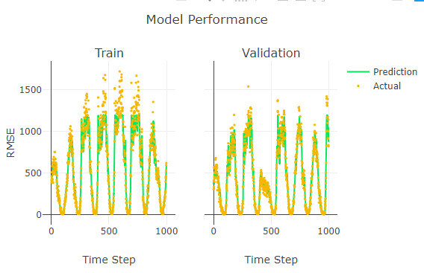
LSTM Networks
Vanilla LSTM(72 steps back)
(52536, 72, 1) (52536, 1) (26040, 72, 1) (26040, 1) 102.62558234688204, 171.80584667366665
Notes:
Going 72 steps back performed less

Slide 43
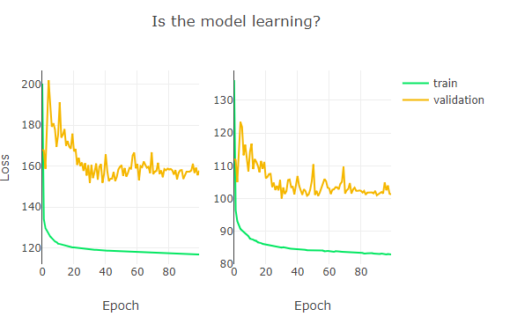
LSTM Networks
Vanilla LSTM(24 steps back, rescaled)
0.030218334914499517, 0.03710274413634326 [[82.94120754]], [[101.26750489]]
Notes:
The best model

Slide 44
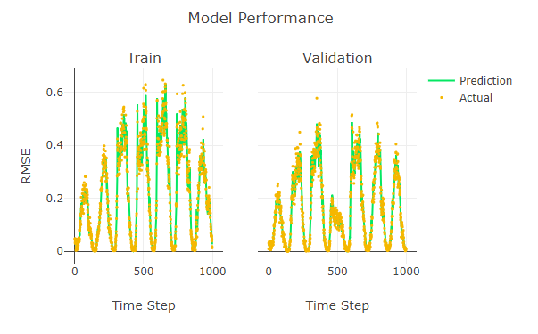
LSTM Networks
Vanilla LSTM(24 steps back, rescaled)
0.030218334914499517, 0.03710274413634326 [[82.94120754]], [[101.26750489]]
Notes:
The best model.

Slide 45
Conclusion
Stacked LSTM performed similar to Vanilla LSTM($100 - $109), more hyperparameter tuning is needed
Generalized model RMSE is $250
Sequence to Sequence Prediction
Consider Drop-off location
Integrate it with other ride-sharing time-series
Project-Link: Github
Notes:
The best model.

Slide 46







References
Project-Link: Github
Notes:
The best model.

Slide 47



References
Notes:
The best model.

Slide 48

Thank you

